Slide 1
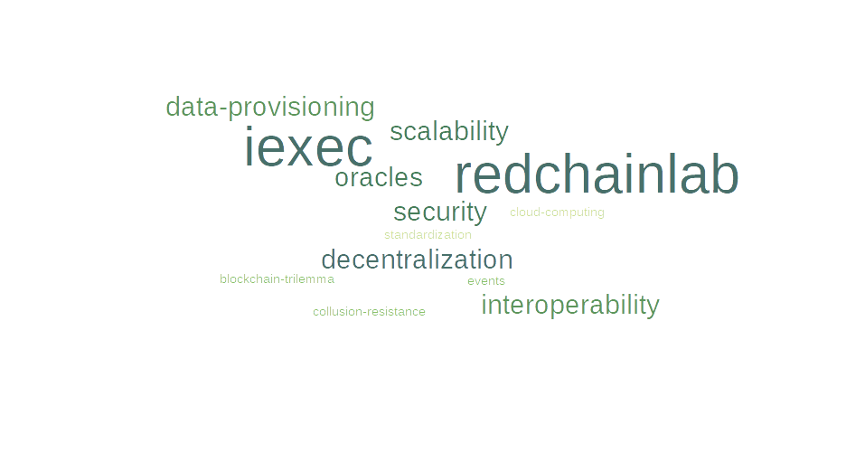
Matthieu BETTINGER

Slide 2
About me
Matthieu BETTINGER
  INSA-IF 2021
  Double-degree with Uni. Passau
2021 projects:
  “Collusion-Resistant Worker Set Selection for Transparent and Verifiable Blockchain-Based Voting” with Lucas Barbero & Omar Hasan
  “Blockchain interoperability – Cross-chain oracles with Decentralized Cloud Computing” with iExec, INSA Lyon & Uni.Passau
2022–2024:
  PhD thesis on “Blockchain interoperability & composability” in RedChainLab

Slide 3
Summary
iExec Decentralized Cloud Computing
Using blockchains to secure applicative protocols
  “Collusion-resistant worker set selection”
RedChainLab
Oracles: Connecting blockchains & the outside world
  Theory & Practice
  Standardization & Interoperability
  Data provisioning trade-offs
  “Oracles with Decentralized Cloud Computing”
Project/Practical work

Slide 4
Goals
Real-world applications of blockchain/smart contract technology, how they secure protocols
Trustworthy data provisioning issues and countermeasures
Event-based programming with Solidity/Web3J(S)

